Slide 1
MOBILE HEALTH MONITORING SYSTEM
ADEGEYE EMMANUEL O. F/HD/15/3210095 OGINNI TOSIN M. F/HD/14/3210035 OMOROJIE DANIEL UCHE F/HD/14/3210208 OMOTAYO IDRIS OPEYEMI F/HD/15/3210183

Slide 2
CONTENTS
CHAPTER ONE | CHAPTER TWO | CHAPTER THREE | CHAPTER FOUR | CHAPTER FIVE
INTRODUCTION | LITERATURE REVIEW | SYSTEM ANALYSIS AND DESIGN | SYSTEM IMPLEMENTATION AND DOCUMENTATION | SUMMARY, CONCLUSION AND RECOMMENDATION
Statement of Problems Aim and Objective of the Study | Electronic Health Mobile Health Mobile Health Monitoring System Related Works | Analysis of the Proposed System System Design Summary | Hardware and Software Specification Testing System Documentation System Evaluation | Conclusion Limitation

Slide 3
INTRODUCTION
Mobile Health is the delivery of healthcare services via mobile communication devices.
The M-Health field has emerged as a sub-segment of E-Health, the use of information and communication technology (ICT), such as computers, mobile phones, communications satellite, patient monitors, etc.
The term M-Health was coined by Malaria Clinic in Tanzania helped by SMS for Life program that uses cell phones to efficiently deliver malaria vaccine Robert Istepanian as use of "emerging mobile communications and network technologies for healthcare" (Curioso & Kurth, 2007).
Mobile Health (also written as M-Health) is a term used for the practice of medicine and public health supported by mobile Nurse using mobile phone devices

Slide 4
STATEMENT OF THE PROBLEM
The Nigerian patients and medical practitioners has always been unable to keep accurate records and also trace the medical records based on individual appointment and job schedule, this has brought about a lot of mix up and has really affected the consistency toward treatment of patient and follow up for appropriate checkup. The traditional approach has been a major disadvantage to the electronic or compact health system that has been introduced to several country. Although several attempts has been made to cater for this by developing a system that can tackle this issue, but they are unreliable, inconsistent, error prone and most time redundancy make them fall below expectation.

Slide 5
AIM AND OBJECTIVES
Aim of the Study
The aim of this project is to develop Mobile Health Monitoring System.
Objectives of the Study
To integrate mobile technology into healthcare service.
ii. To develop an application that allows users to track and monitor their health record with measure reminder.
To develop an application that allows users to upload and download information of health record and management.

Slide 6
ELECTRONIC HEALTH
E-Health is an abbreviation for electronic health, a term used for the practice of medicine and public health supported by electronic Nurse using an electronic means or several country devices.
E-Health applications includes
Mobile devices in collecting community and clinical health data.
Delivery of healthcare information to practitioners.
Real-time monitoring of patient vital signs.
Direct provision of care (via mobile telemedicine).

Slide 7
MOBILE HEALTH
M–Health is by definition based on mobile technology such as smartphones, healthcare, through information and delivery, can better reach areas, people, and/or healthcare practitioners with previously limited exposure to certain aspects of healthcare.
Mobile Health Devices.
Mobile Phone
Smart Phone
Mobile Health Monitoring System
The Mobile Health Monitoring System is a system that assist the patients/medical officials to access the needy information from the cloud resource about any registered patient using mobile device in other to have quick and easy access to his/her health information/appointments.

Slide 8
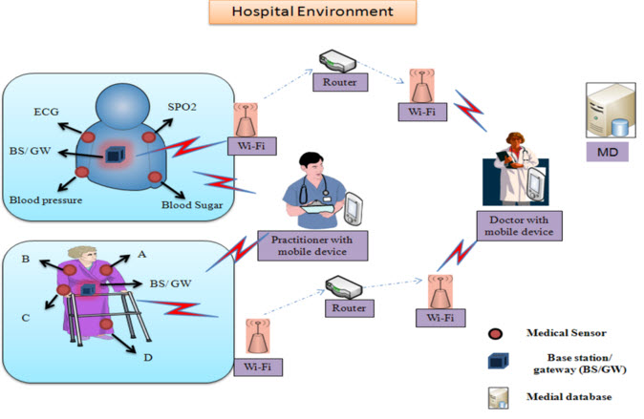
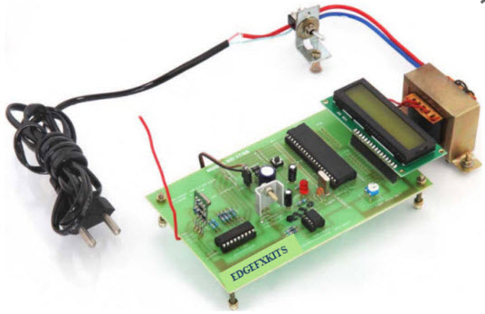
RELATED WORKS
1. Automatic Wireless Health Monitoring System using Circuit (Frank, Alimi & Kenyo, 2014).
2. Mobile health monitoring system based on activity recognition using accelerometer (Kenton, 2015).

Slide 9
SYSTEM ANALYSIS
This project bridges the gap of patient having to carry many devices for different disease which most times does not give accurate result and can lead to more issue than expected.
The project provide interfaces for patient, medication expert and other to properly monitor and update patient health issue on real time.
The project will help patient, medical expert and relatives keep track of patient health providing different level of accessibility for different level of users The system consists of database that manages all the health record and compiles it to generate feedback that helps the patient to monitor the details of how to manage and monitor his health issue by paying attention to medication and visit for medical check-up

Slide 10
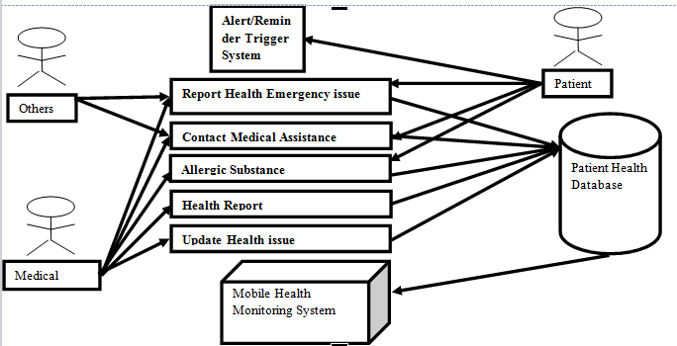
SYSTEM ARCHITECTURE DESIGN

Slide 11
INPUT DESIGN
The database requires tables of entities that contain different fields and attributes that define the entity. We have table for the patient record where the patient health issue are typed in by the user and saved in the database table. The input design is as depict in the following slides.

Slide 12
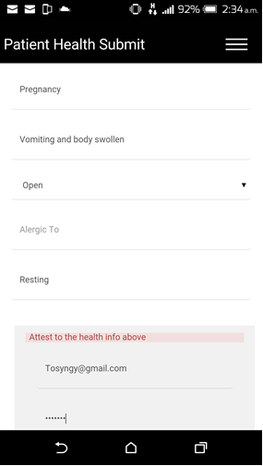
Patient Health Submit Input Snapshot
The Patient Health Submit allows the user to supply his health information base on the field parameters. The user supply record can only be submitted successful after the attestation of a doctor by supplying his user id for authentication.

Slide 13
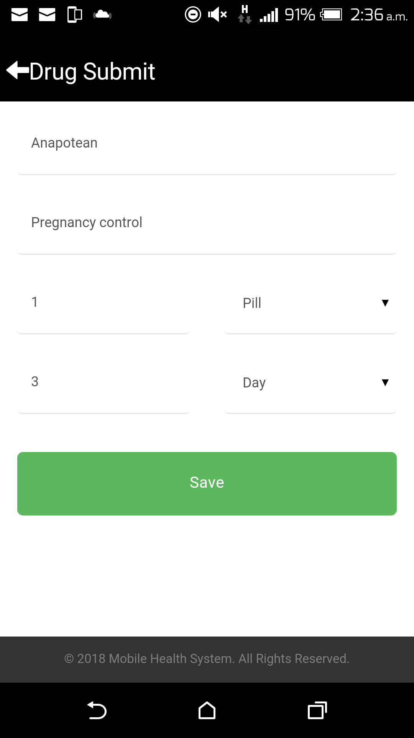
Drug Submit Input Snapshot
The Drug Submit allows the user to supply his medication information base on the field parameters. For the user to submit medication record and health issue must have been attached to it.

Slide 14
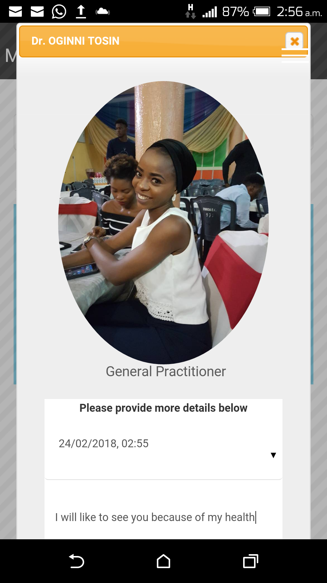
Book Appointment Input Snapshot
The Book Appointment page is one of the most relevant pages of this system, it allow user to select a particular doctor and book appointment with him, with the need to supply the date for the meeting and the description of the appointment.

Slide 15
OUTPUT DESIGN
This is where the designed form on which our desired output is displayed and it has to do with the actual interface. It is the output design that will determine the input and method of processing. In the output design, we have report such as:
List of patient health records
List of patient medical appointment or reminder

Slide 16
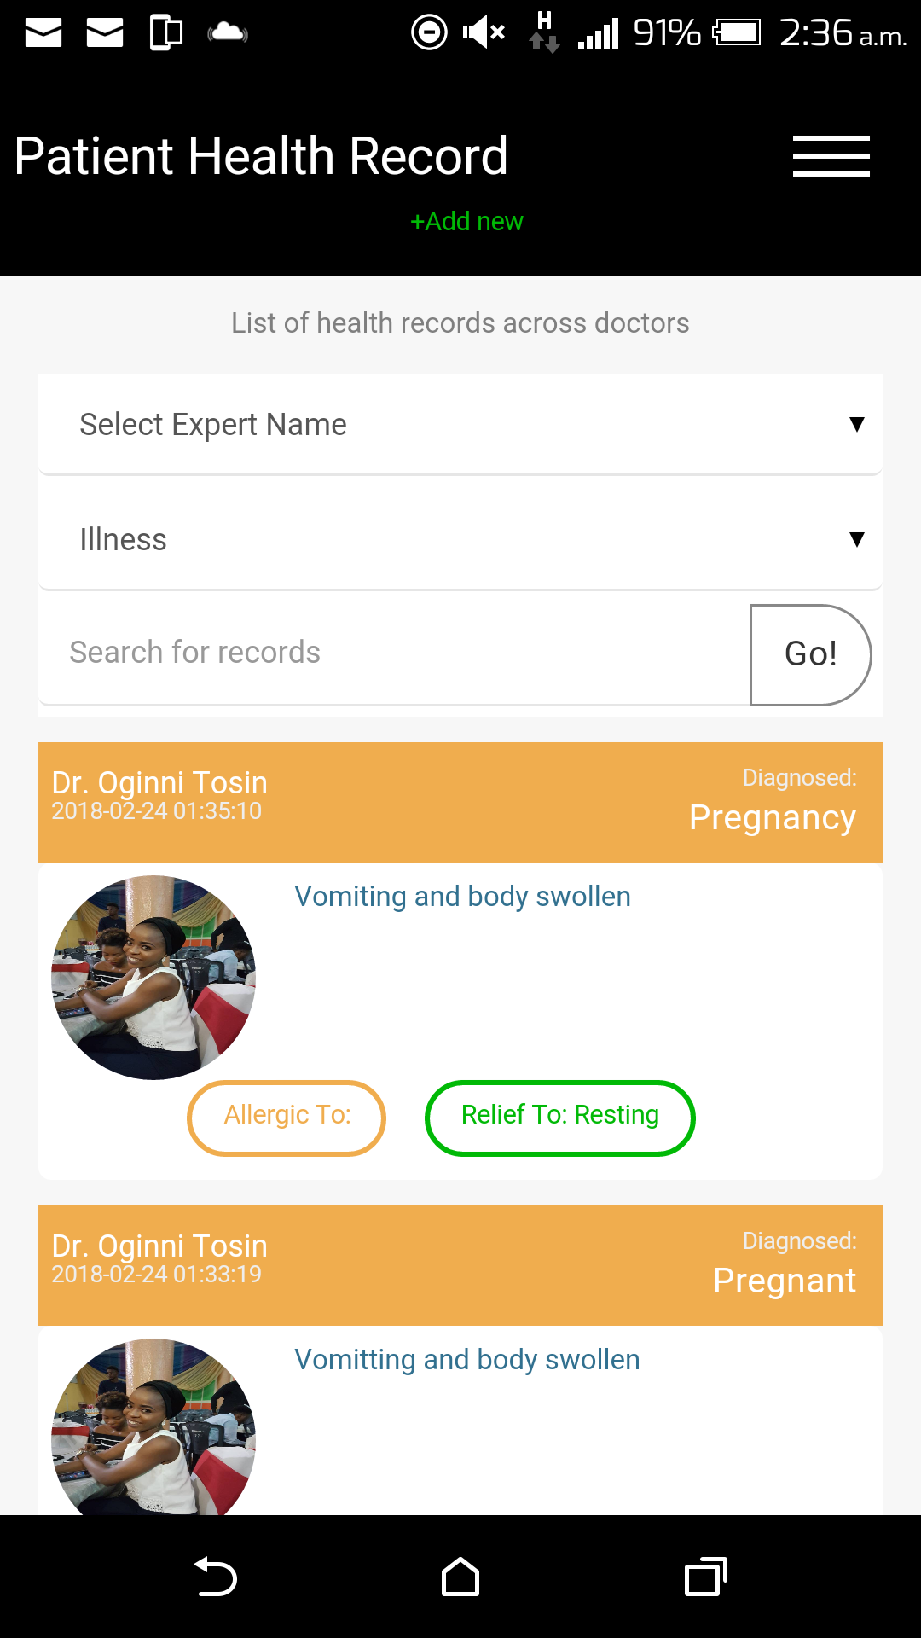
Patient Health Record Input Snapshot
The Patient Health record provide user with the list of his health information base on the field parameters. The parameter can either be defined or specify.

Slide 17
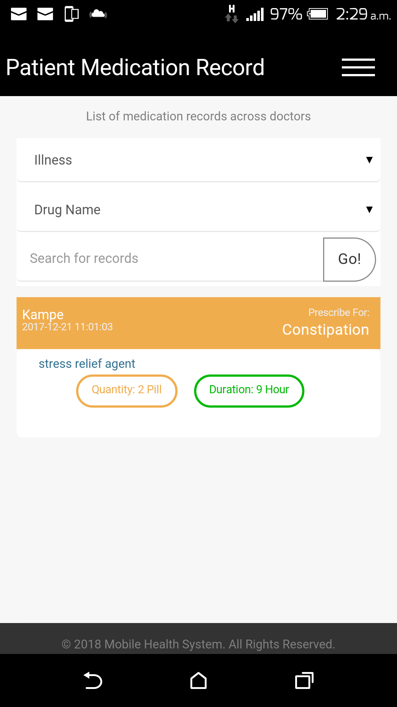
Patient Medication Record Input Snapshot
The Patient Medication record provide user with the list of his medication information base on the field parameters. The parameter can either be defined or specify. The purpose of the parameter is to filter the output information.

Slide 18

Meet Experts Page

Slide 19
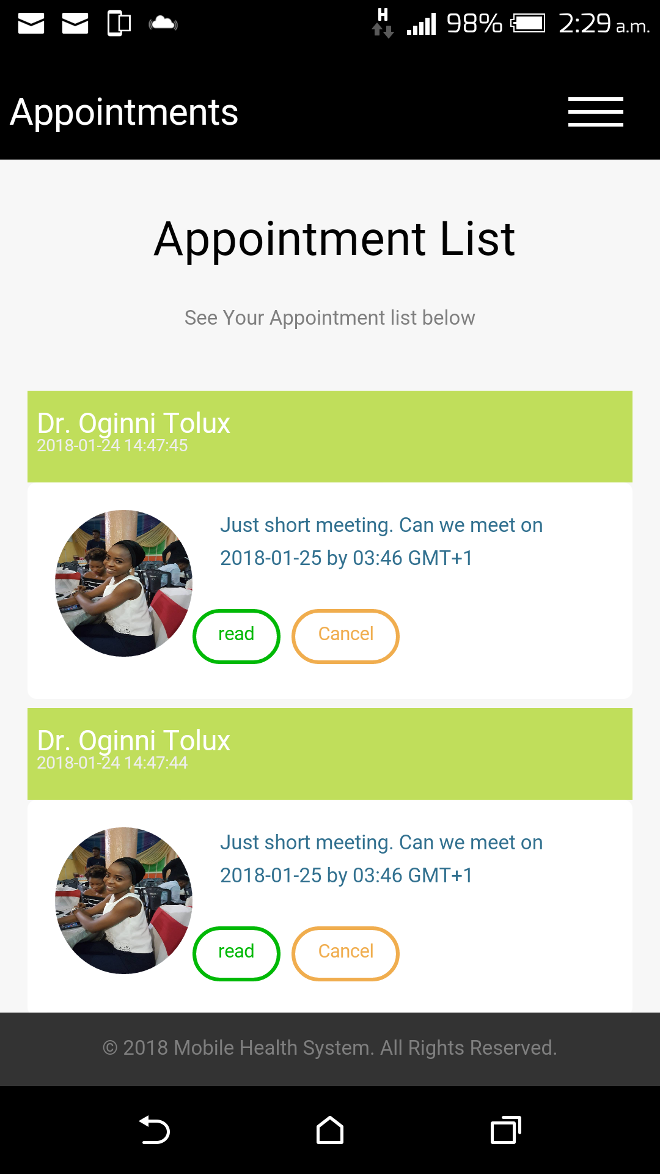
Appointment List Input Snapshot
The Appointment List page is triggered from the meet expert page where medical experts can be search for and filter. The appointment list page is one of the most relevant pages of this system, it allow user to view the progress of their appointment with each doctor

Slide 20
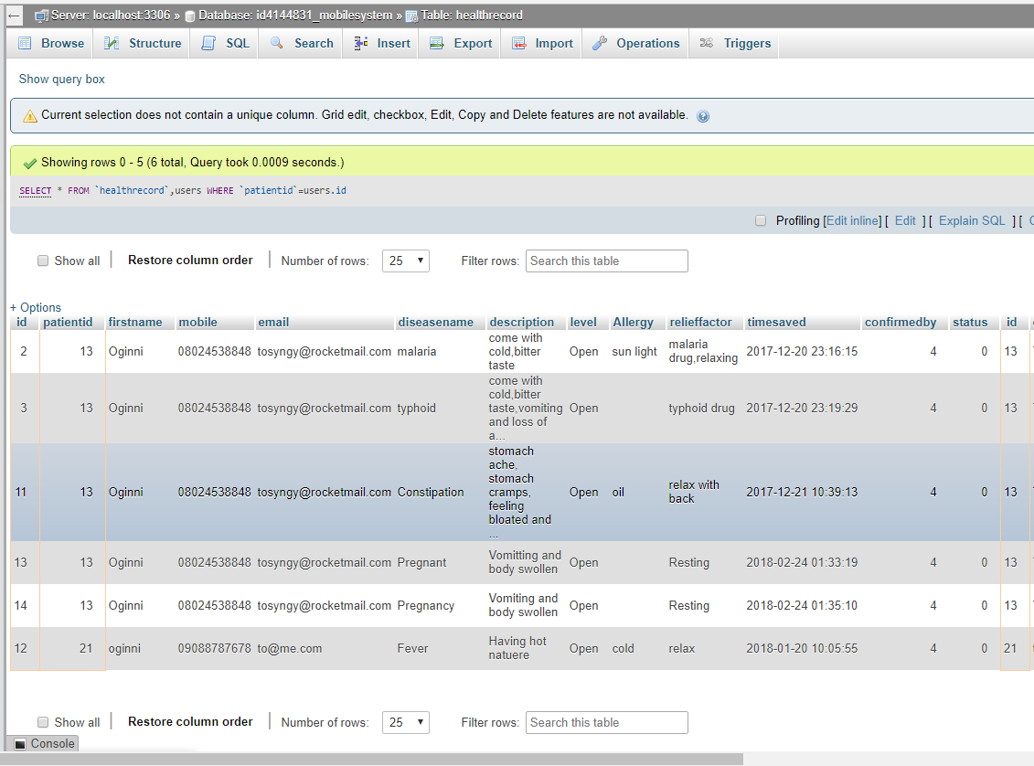
DATABASE DESIGN
The database used to design was MySQL. This database makes use of tables for retrieval and insertion of information. Appropriate data fields (data structure and validation rules) were formulated to serve as tools. It is also used in facilities queries and to hold records as well as create queries and reports.

Slide 21
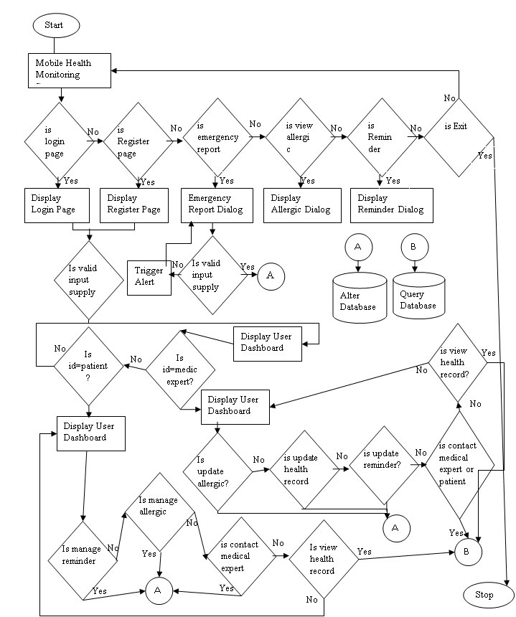
SYSTEM FLOWCHART

Slide 22
HARDWARE AND SOFTWARE SPECIFICATION
SOFTWARE SPECIFICATION
The following are the software requirements for this application
Android OS.
Java Runtime Environment (version 5.0 and above).
Android Emulator
Android Development tool(ADT)
4.3.2 HARDWARE SPECIFICATION
The above listed software will work perfectly with the under listed specification, as a computer is not complete without either the software or the hardware
Android smartphone or android ADT for simulation.
1GB Memory (RAM) or Higher.
High resolution of display unit.
Device Internal of 16GB Minimum.

Slide 23
IMPLEMENTATION PHASE
The implementation phase of this project is divided into two which are the patient and medical expert these phases are explained below:
Patient Phase: The patient interface is the main implementation of the project, intercepting with the function and modules available on the system. The patient implementation comprise of health monitoring managing pages, medication monitoring managing pages as well as appointment managing page. This is the summary of all pages available on the system.
Medical Expert Phase: This is the phase is limited to only medical professionals with the interface to attend to patient appointment details and also update patient information, alongside every module on the patient phase
Others Phase: This is the only meaningful health monitoring phase that can be access before logging to the system. The purpose of this page is for emergency and rescue.

Slide 24
SYSTEM DOCUMENTATION
Installation Procedure
This project has been developed and package into an apk file that can be install on android OS device with no additional requirement apart the device.
.
The following are the step involve in installing this Application
Let your android device be up and runing
Go to Google playstore to download the apk file or share the file with a friend
Click on the file to install and accept the require permission
After installing the application launch the application and you will be good to go

Slide 25
SYSTEM EVALUATION
The project provide interfaces for patient, medication expert and other to properly monitor and update patient health issue in real time, it solves the issue of having to carry several gadget for different health problems. The project help patient, medical expert and relatives keep track of patient health providing different level of accessibility for different level of users The system consists of database that manages all the health record and compiles it to generate feedback that helps the patient to monitor the details of how to manage and monitor his health issue by paying attention to medication and visit for medical check-up.

Slide 26
SUMMARY
Mobile Patient Monitoring System is a component of telemedicine
The project provide interfaces for patient, medical expert and other to properly monitor and update patient health issue in real time.
This system solves the issue of having to carry several gadget for different health problems.
It provide different level of accessibility for different level of users for purpose of security.
The system consists of database that manages all the health record and compiles it to generate feedback that helps the patient to monitor the details of how to manage and monitor his health issue by paying attention to medication and visit for medical check-up.
The project is design using Java Android Technology, XML and fragment to design the interface and the MYSQL to manage the backend database

Slide 27
REFERENCES
Atun RA, Mohan A. Uses and benefits of SMS in healthcare delivery. London, Imperial College London, 2015.
Chew ZW. Comparison of an SMS text messaging and phone reminder to improve attendance at a health promotion center: a randomized controlled trial. Journal of Zhejiang University SCIENCE B (Biomedicine & Biotechnology), 2008, 9(1):34–38.
Hurling R. Using Internet and mobile phone technology to deliver an automated physical activity program: randomized controlled trial. Journal of Medical Internet Research, 2007, 9(2):e7.
Ivatury G, Moore J, Bloch A. A doctor in your pocket: health hotlines in developing countries. Innovations: Technology, Governance, Globalization, 2009, 4(1):119–153.

Slide 28
THANK YOU !

